Slide 1
Ggplot2 and interactive graphics with R
Christophe Ladroue
SECTION 02
Making basic plots
www.PacktPub.com

Slide 2
In this section we’re going to take a look at
Drawing lines
Drawing paths
Drawing bar plots
Drawing histograms and density plots
Drawing boxplots

Slide 3
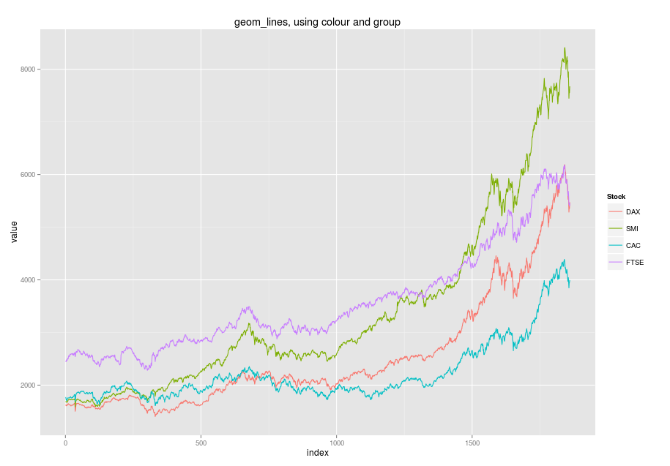
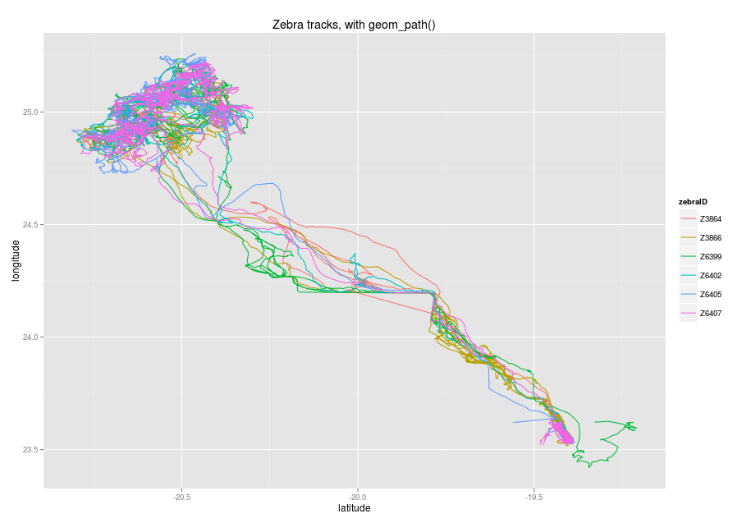
In this video we took a look at
how to use geom_line() to connect points together
how to use the group aesthetic to collect identical levels of a factor together.
Next: paths

